Slide 1
Stacks

Slide 2
A stack is a linear data structure in which the insertion of a new element and removal of an existing element takes place at the same end represented as the top of the stack.
A stack is a linear data structure that follows the principle of Last In First Out (LIFO). This means the last element inserted inside the stack is removed first.

Slide 3
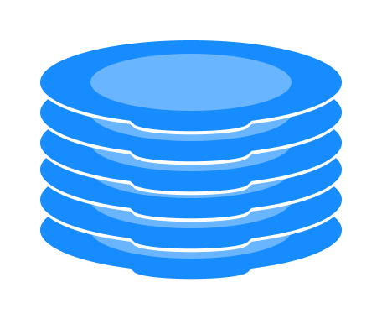
Stack representation as a pile of plates

Slide 4
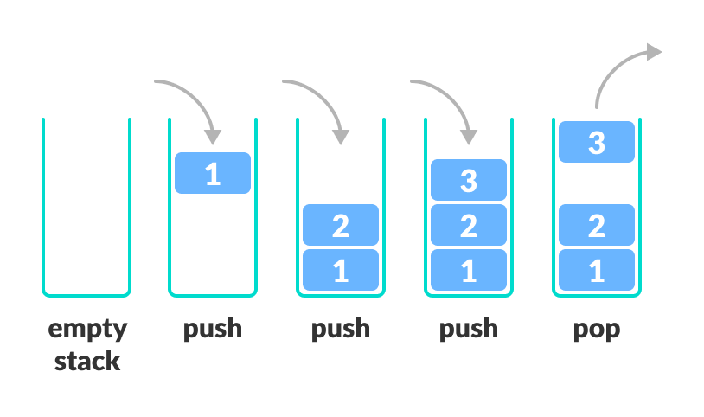
Stack PUSH and POP operations

Slide 5
Stack operations
There are some basic operations that allow us to perform different actions on a stack.
Push: Add an element to the top of a stack
Pop: Remove an element from the top of a stack
IsEmpty: Check if the stack is empty
IsFull: Check if the stack is full
Peek: Get the value of the top element without removing it

Slide 6
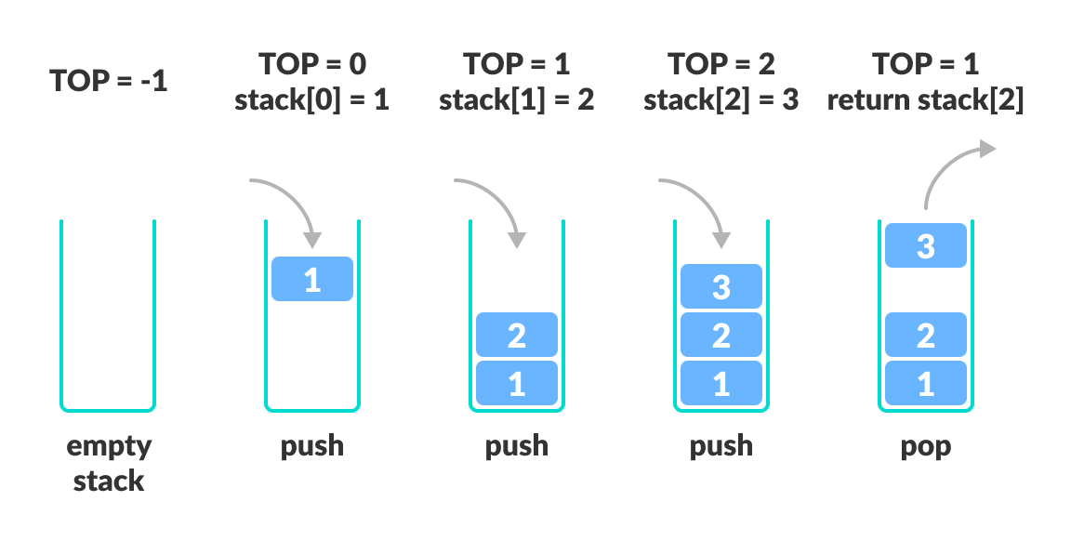
Working of Stack

